Slide 1
Table Talk with MDH Project Firstline Team
Website: Project Firstline | Email: Project.Firstline.MDH@state.mn.us

Slide 2
Agenda
Welcome
Project Firstline Initiative
  Meet the Team
  Website and Subscribe
Trainings
  Live and Recorded
Resources
Conclusion

Slide 3

Learning Objectives
Increase awareness of the Minnesota Department of Health (MDH) Project Firstline (PFL) initiative.
Recognize the role that all frontline healthcare workers have in preventing the spread of germs (preventing infectious disease transmission).
Identify and access MDH PFL trainings and resources.

Slide 4
Introduction
Minnesota Department of Health (MDH) Project Firstline (PFL).
What is Project Firstline?
It is a partnership between the Centers for Disease Control (CDC) and MDH. Project Firstline (PFL) is a collaborative of diverse healthcare and public health partners that aims to provide engaging and effective infection prevention and control training to frontline healthcare workers, staff and members of the public health workforce.
Its innovative content is designed so that—regardless of role, previous training or educational background— staff can understand and confidently apply the infection control principles and protocols necessary to protect themselves, their facility, their family, and their community from infectious disease threats.

Slide 5
Introduction: Meet the team
Caramae S., BS
Project Firstline Team Lead
Planner Intermediate, Infection Control Assessment and Response Team (ICAR)
Pamela P., RN, ND
PFL Planner Intermediate
Amanda K., RN, MSN, PHN
PFL Nurse Specialist
Britt B., MPH
Epidemiologist, Infection Control Assessment and Response Team (ICAR)
Callie F.
Project Firstline Health Educator
Katie H.
Communications Specialist, Infectious Disease Epidemiology, Prevention and Control Division (IDEPC)

Slide 6
Project Firstline
Website Trainings & Resources

Slide 7
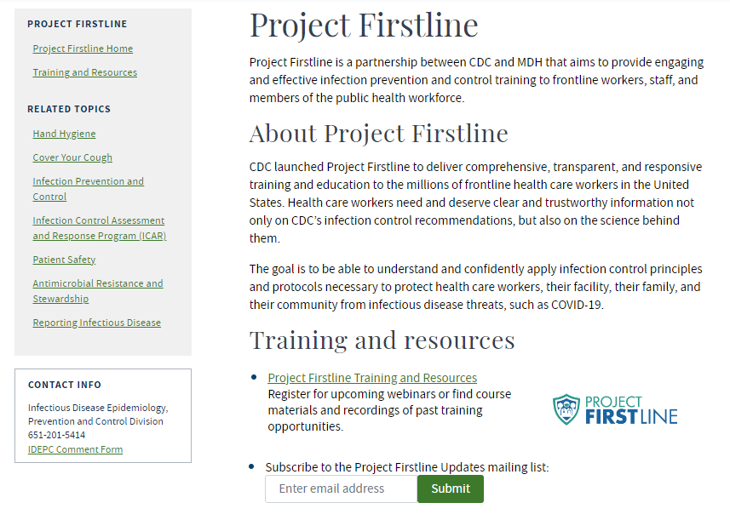

Website and Subscribe

Slide 8
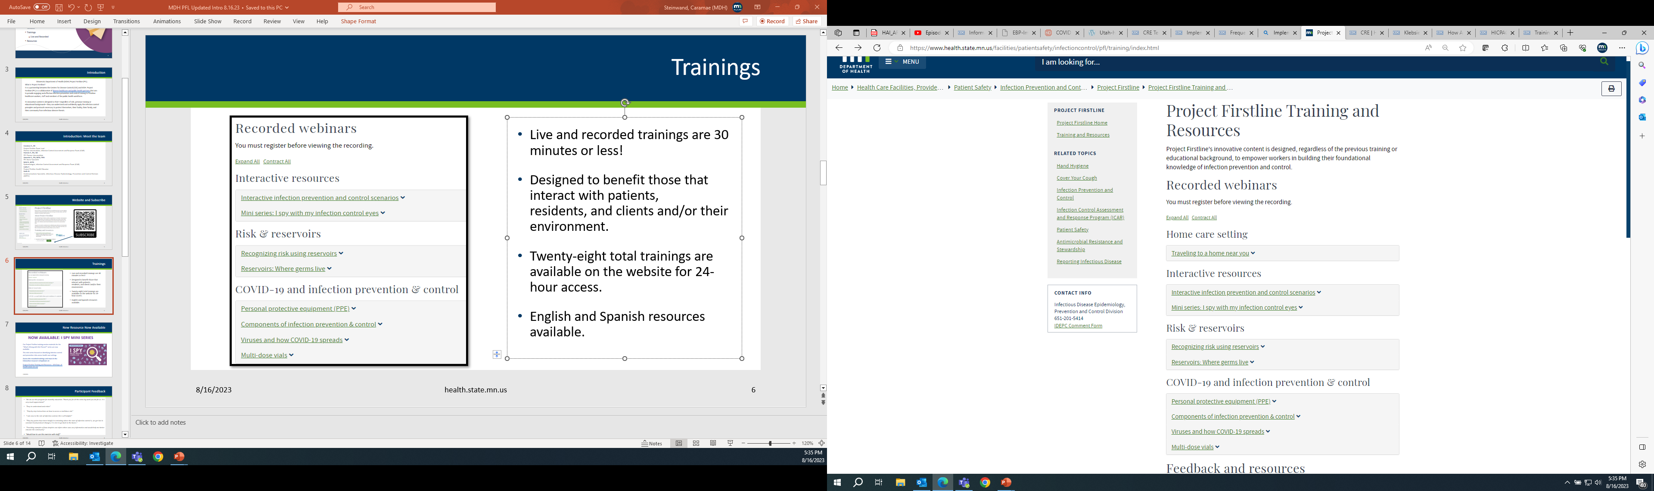
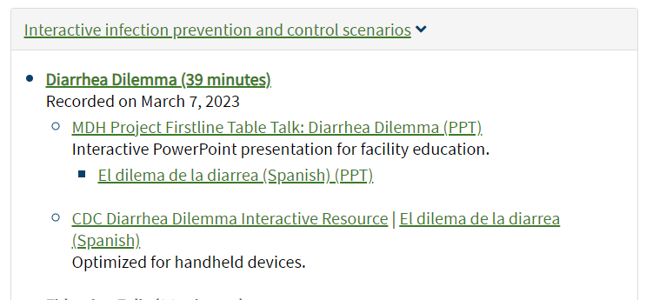
Training and Resources Webpage
Live and recorded trainings are 30 minutes or less!
Designed to ​benefit those that interact with patients, residents, ​and clients and/or their environment​. ​
Twenty-eight total trainings are available on the website for 24-hour access.
English and Spanish resources available.
Proof of Attendance is now offered for live sessions and recorded sessions!

Slide 9
Participant Feedback
  “We do use this program for monthly education. Thank you for all the extra leg work you do for us. It is very much appreciated!”
  “Easy to understand and relate”
  “Step by step instructions on how to access a multidose vial.”
  “I am new to the role of Infection control; this is all helpful!”
  “They key points have been helpful in reminding where the start of infection control is, we get lost in constant Covid protocol changes; it is nice to go back to the basics.”
  “Providing examples of how droplets can infect others was very informative and would help me better educate the community.”
  “Would love to use this exercise with staff.”

Slide 10
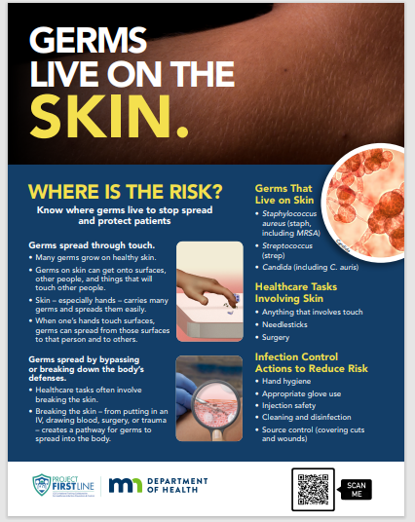
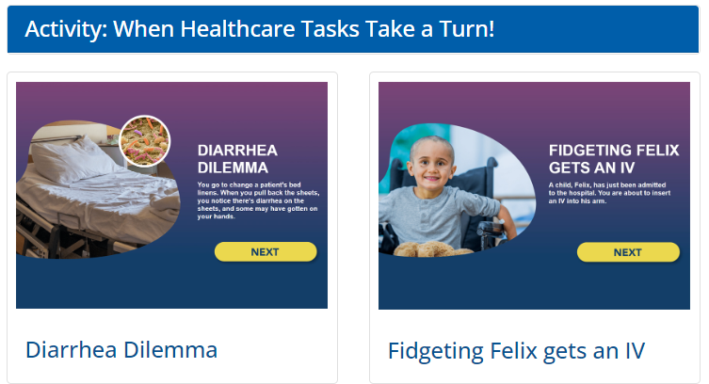
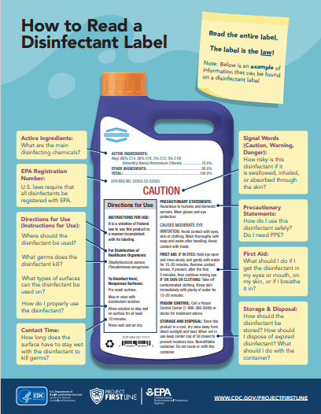
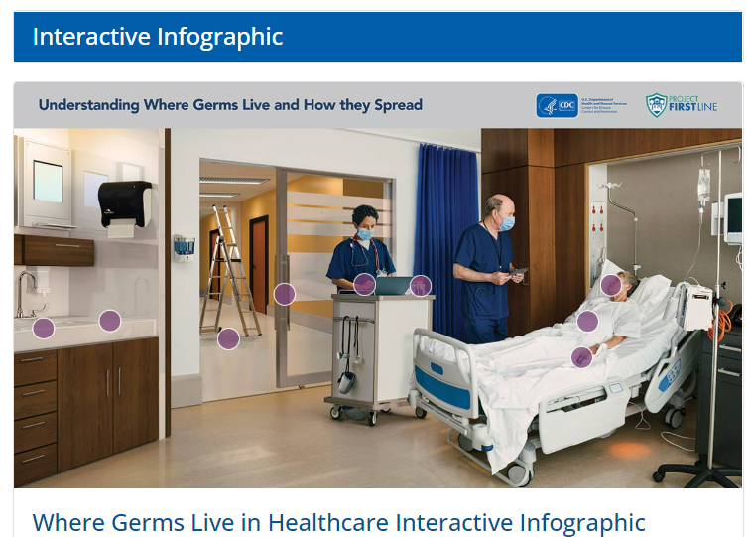
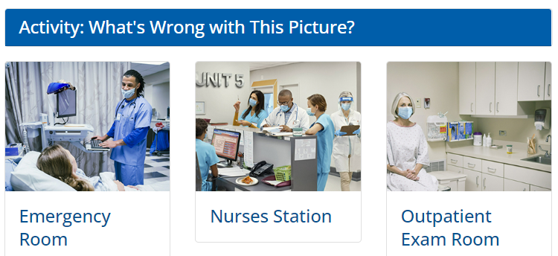
Interactive and Printable Resources

Slide 11
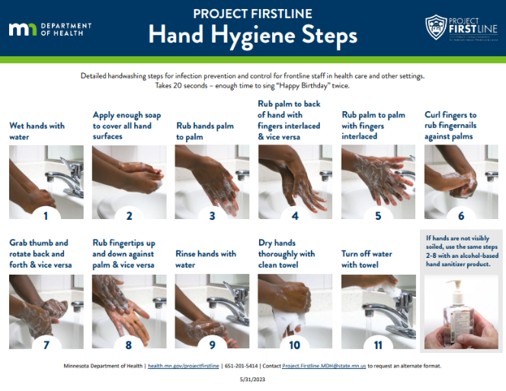
New Resource: Hand Hygiene
New Hand Hygiene Poster
Project Firstline Hand Hygiene Steps (PDF)

Slide 12

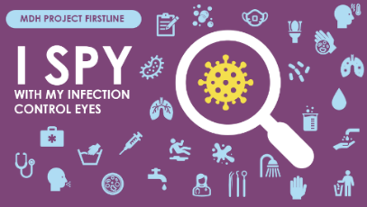
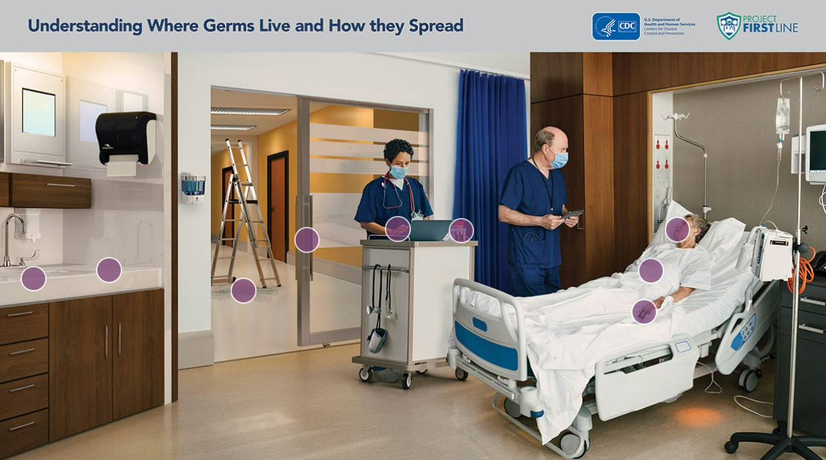
New Resources: Interactive Trainings
Infection Prevention and Control: Traveling to
a Home Near You
Understanding Where Germs Live and How
They Spread
MINI SERIES: I Spy With My Infection Control Eyes

Slide 13
Interactive Training Demo
Understanding Where Germs Live and How they Spread

Slide 14
Understanding Where Germs Live and How they Spread
FINISH

Slide 15

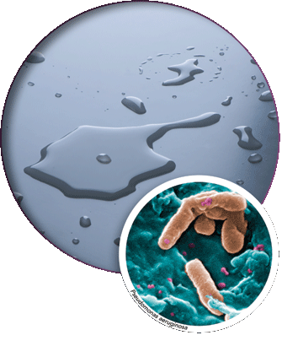

Water and wet surfaces are reservoirs for germs.
Infection Control Actions:
Cleaning and disinfection
Device sterilization
Hand hygiene
Use of personal protective equipment (gloves, gowns, eye protection)
How Germs Spread from Water and Wet Surfaces
A water puddle on a countertop and a close view of germs
Tap water is safe to drink, but it is not sterile. It always has some germs in it.
Most of the time, the germs in tap water aren't a problem for healthy people, but they can cause illness in patients with very weak immune systems.
If medical instruments and equipment (e.g., devices and central lines) get wet, bacteria can grow. When those devices are used, that bacteria can then get into a patient's body or blood and cause infection.

Slide 16
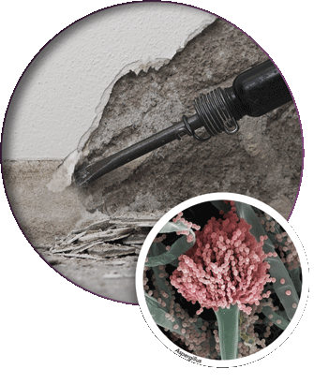
Dirt and dust are reservoirs for germs.
Infection Control Actions:
Cleaning and disinfection
Ventilation
Using barriers and other types of construction containment
Hand hygiene
How Germs Spread from Dirt and Dust
Germs live in dirt and soil. Most of the time they aren't a problem for healthy people but can cause serious illness in people with weakened immune systems.
Building construction can send dirt and the germs in it into the air, which can then get inside a health care facility.
Smaller construction and maintenance projects inside a building – like taking out parts of a wall, removing ceiling tiles, or renovating a room – can also create dust that has germs in it.

Slide 17
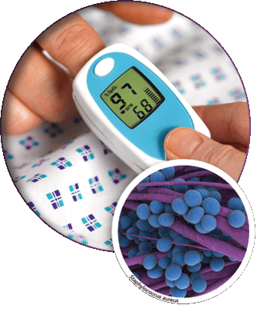
Medical devices are reservoirs for germs.
Infection Control Actions:
Cleaning and disinfection
Device sterilization
Hand hygiene
Use of personal protective equipment (gloves)
How Germs Spread from Medical Devices
When a device, like a pulse oximeter, is used on a patient's body to provide care, any germs on that device can be spread to places in or on the patient's body.
When a device is put into a patient's body, like an IV needle, endoscope, or artificial hip, any germs on the device can spread into the body.
If not handled correctly, shared medical devices can spread germs from one patient to another.

Slide 18
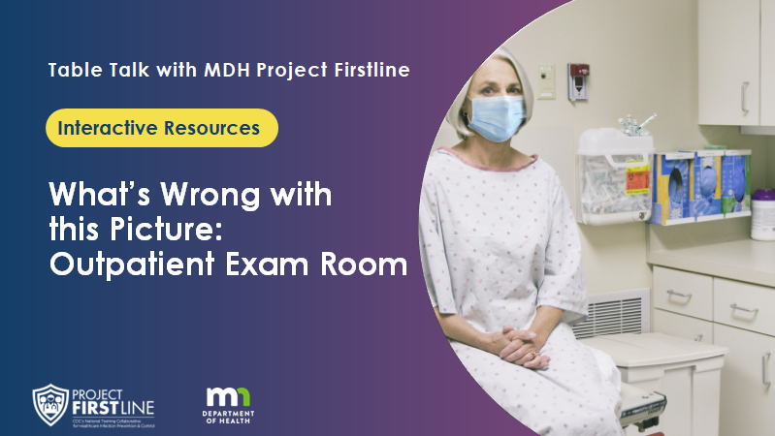
What’s Wrong With This Picture? Outpatient Exam Room
Interactive Training Mini Series: I Spy With My Infection Control Eyes

Slide 19
What’s Wrong with this Picture:
Outpatient Exam Room
Table Talk with MDH Project Firstline
Interactive Resources

Slide 20
Agenda
Welcome
Welcome and Introductions
What’s Wrong with this Picture: Outpatient Exam Room
Conclusion

Slide 21
What’s Wrong with this Picture: Outpatient Exam Room

Slide 22
What’s wrong with this picture?
Health care workers need to be extra aware of where germs are found and how they can be spread to surfaces and people.
We can help stop infections when we recognize the risk for germs to spread!
In this outpatient room, select four problems that need to be fixed to reduce the spread of germs.
Finish

Slide 23
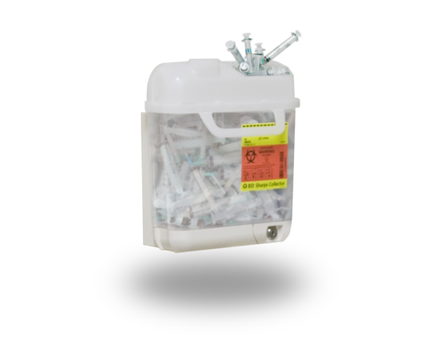


Overflowing Sharps Container
Next
When sharps containers are overfilled, there is greater risk of accidentally getting poked with a dirty needle or sharp instrument. Remove or replace frequently-used sharps containers often, and before they become too full.

Slide 24
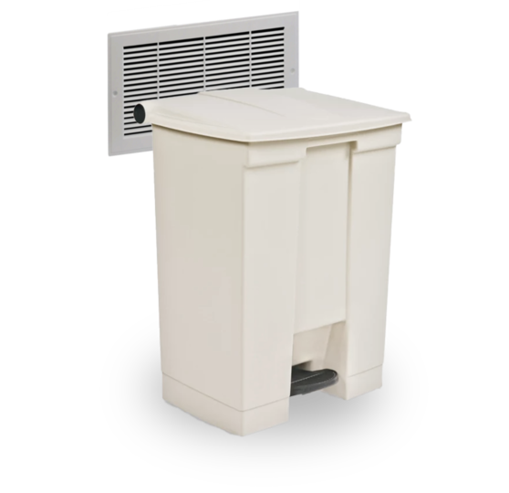
Blocking a Vent
Next
A blocked vent can decrease the air handling system's ability to replace the air in a room with new, clean air.
If you see an air vent blocked by something mobile, like a chair or a trashcan, move the item to improve ventilation. If a vent is blocked by something else, like cabinets, notify a supervisor or the person in charge of the area.

Slide 25
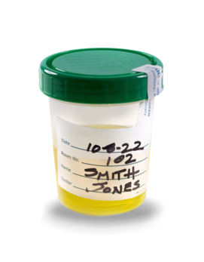
Urine Specimen Without a Biohazard Bag
Next
When a sample from a patient is collected, body fluids and germs can easily get on the outside of the container and spread. These samples should be placed in a biohazard bag to prevent the spread of germs.

Slide 26
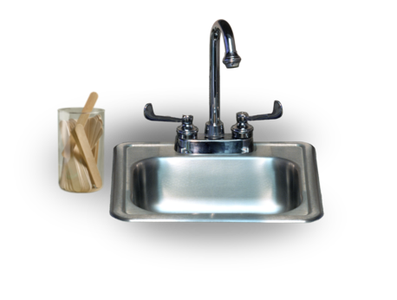
Placing Supplies Close to the Sink
Next
Tap water is clean, but it is not sterile. Places that are frequently wet with tap water or sprayed by tap water, like sinks and the counters around sinks, can be a risk for germs in water to spread. That's why it's important to keep health care supplies away from water.

Slide 27
Reflection
You did it! Thanks for exploring this common health care setting and identifying infection control problems.
Have you ever encountered them in your workplace?
If so, why do you think they are so common? What could we do to stop them?

Slide 28
Conclusion

Slide 29

Feedback Poll

Slide 30
Project Firstline Partnership

Slide 31
Partnership
IPC training opportunities
  Quick content refreshers (including huddle resources), annual/quarterly training needs, new employee onboarding, train-the-trainer
Newsletters & email communications
  Partners send weekly, bi-weekly, quarterly newsletters or bulletins
  Members can subscribe to MDH PFL mailing list
Social media engagement
  Facebook, Twitter, Instagram, LinkedIn
Partner meetings & presentations
  Monthly, bi-monthly, or quarterly meeting attendance
Conferences

Slide 32

Thank you
Funny Minute
What did one bacteria say to the other bacteria?
Let’s make like an amoeba and split!

Slide 33






Contact Us
MDH Project Firstline http://health.mn.gov/projectfirstline
Subscribe to MDH Project Firstline Mailing List https://public.govdelivery.com/accounts/MNMDH/subscriber/new?topic_id=MNMDH_673
Minnesota Department of Health (@mnhealth)| Facebook
Minnesota Department of Health (@mnhealth)| Twitter
Minnesota Department of Health (@mnhealth) | LinkedIn
Minnesota Department of Health (@mnhealth)| Instagram
CDC Project Firstline (cdc.gov) | Facebook | Twitter | Emails

Slide 34


Questions

